Slide 1

Part I Applied Math and Machine Learning Basics
Part I Applied Math and Machine Learning Basics
Acknowledge to: Meiju Wang
Organizers: Guoqiang Zhong, Zhaoyang Niu
Machine Learning Research Group
Ocean University of China
Qingdao, China

Slide 2

Part I Applied Math and Machine Learning Basics
This part of the book introduces the basic mathematical concepts needed to understand deep learning. We begin with general ideas from applied math that allow us to deﬁne functions of many variables, ﬁnd the highest and lowest points on these functions and quantify degrees of belief.
Next, we describe the fundamental goals of machine learning. We describe how to accomplish these goals by specifying a model that represents certain beliefs, designing a cost function that measures how well those beliefs correspond with reality and using a training algorithm to minimize that cost function.
This elementary framework is the basis for a broad variety of machine learning algorithms, including approaches to machine learning that are not deep. In the subsequent parts of the book, we develop deep learning algorithms within this framework.

Slide 3
Chapter 2 Linear Algebra
2 Linear Algebra
Acknowledge to: Meiju Wang
Organizers: Guoqiang Zhong, Zhaoyang Niu
Machine Learning Research Group
Ocean University of China
Qingdao, China

Slide 4
Chapter 2 Linear Algebra
2.1 Scalars, Vectors, Matrices and Tensors
2.2 Multiplying Matrices and Vectors
2.3 Identity and Inverse Matrices
2.4 Linear Dependence and Span
2.5 Norms
2.6 Special Kinds of Matrices and Vectors
2.7 Eigendecomposition
2.8 Singular Value Decomposition
2.9 The Moore-Penrose Pseudoinverse
2.10 The Trace Operator
2.11 The Determinant
2.12 Example: Principal Components Analysis

Slide 5
2 Linear Algebra
Linear algebra is a branch of mathematics that is widely used throughout science and engineering. However, because linear algebra is a form of continuous rather than discrete mathematics, many computer scientists have little experience with it. A good understanding of linear algebra is essential for understanding and working with many machine learning algorithms, especially deep learning algorithms. We therefore precede our introduction to deep learning with a focused presentation of the key linear algebra prerequisites.

Slide 6
2 Linear Algebra
If you are already familiar with linear algebra, feel free to skip this chapter. If you have previous experience with these concepts but need a detailed reference sheet to review key formulas, we recommend The Matrix Cookbook (Petersen and Pedersen, 2006). If you have no exposure at all to linear algebra, this chapter will teach you enough to read this book, but we highly recommend that you also consult another resource focused exclusively on teaching linear algebra, such as Shilov (1977). This chapter will completely omit many important linear algebra topics that are not essential for understanding deep learning.

Slide 7
Chapter 2 Linear Algebra
2.1 Scalars, Vectors, Matrices and Tensors
Acknowledge to: Meiju Wang
Organizers: Guoqiang Zhong, Zhaoyang Niu
Machine Learning Research Group
Ocean University of China
Qingdao, China

Slide 8
2.1 Scalars, Vectors, Matrices and Tensors
The study of linear algebra involves several types of mathematical objects:
• Scalars: A scalar is just a single number, in contrast to most of the other objects studied in linear algebra, which are usually arrays of multiple numbers. We write scalars in italics. We usually give scalars lower-case variable names. When we introduce them, we specify what kind of number they are. For example, we might say “Let s ∈ be the slope of the line,” while defining a real-valued scalar, or “Let n ∈ be the number of units,” while defining a natural number scalar.

Slide 9
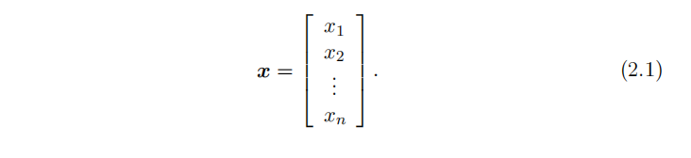
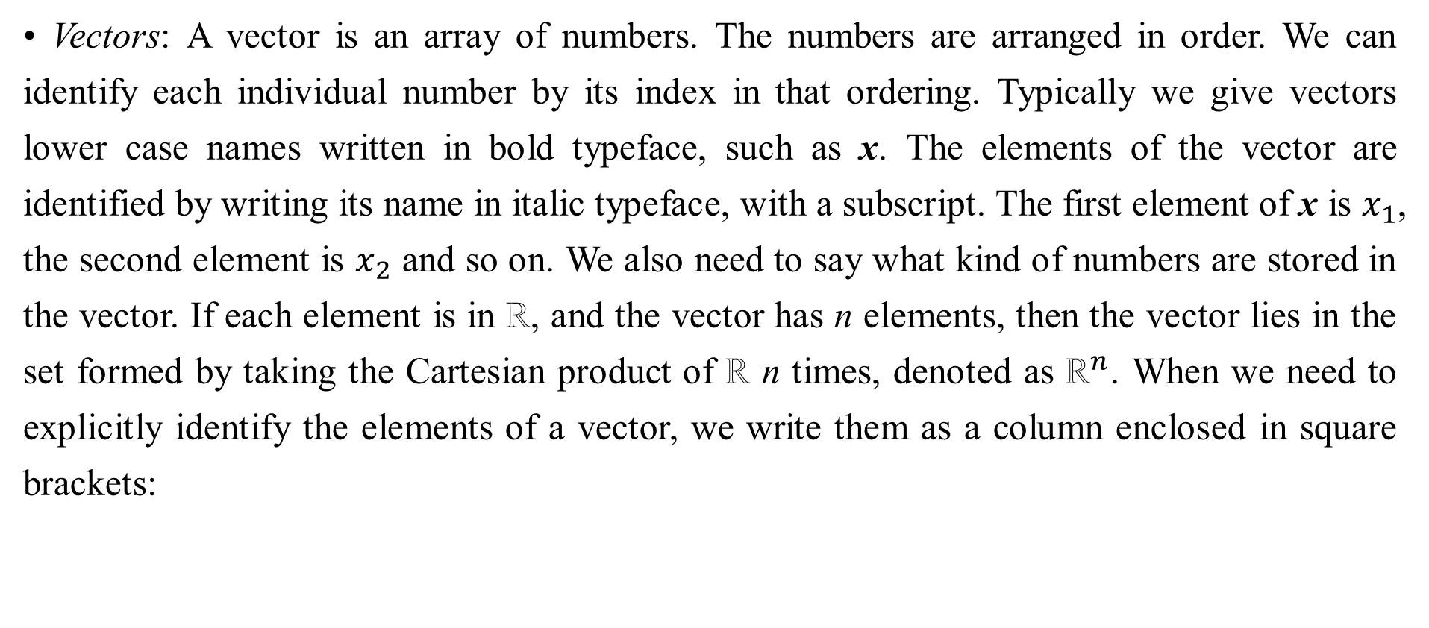
2.1 Scalars, Vectors, Matrices and Tensors
• Vectors: A vector is an array of numbers. The numbers are arranged in order. We can identify each individual number by its index in that ordering. Typically we give vectors lower case names written in bold typeface, such as x. The elements of the vector are identified by writing its name in italic typeface, with a subscript. The first element of x is $x_{1}$, the second element is $x_{2}$ and so on. We also need to say what kind of numbers are stored in the vector. If each element is in ℝ, and the vector has n elements, then the vector lies in the set formed by taking the Cartesian product of ℝ n times, denoted as ${\text{ℝ}}^{n}$. When we need to explicitly identify the elements of a vector, we write them as a column enclosed in square brackets:

Slide 10
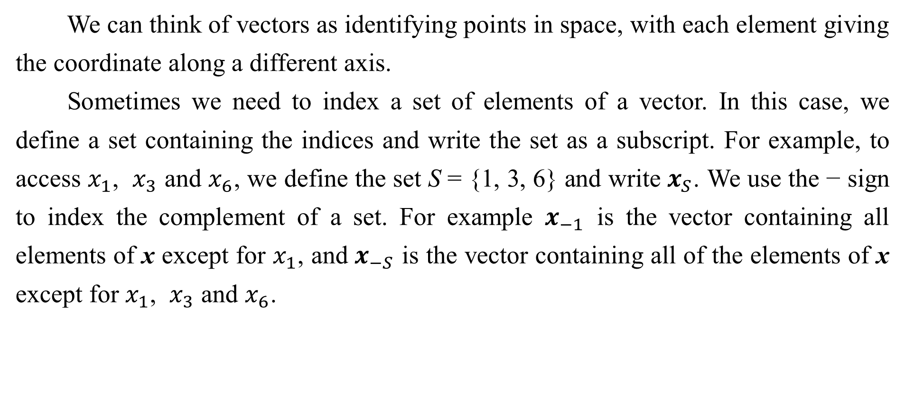
2.1 Scalars, Vectors, Matrices and Tensors
We can think of vectors as identifying points in space, with each element giving the coordinate along a different axis.
Sometimes we need to index a set of elements of a vector. In this case, we define a set containing the indices and write the set as a subscript. For example, to access $x_{1}$, $x_{3}$ and $x_{6}$, we define the set S = {1, 3, 6} and write $x_{S}$. We use the − sign to index the complement of a set. For example $x_{−1}$ is the vector containing all elements of x except for $x_{1}$, and $x_{−S}$ is the vector containing all of the elements of x except for $x_{1}$, $x_{3}$ and $x_{6}$.

Slide 11
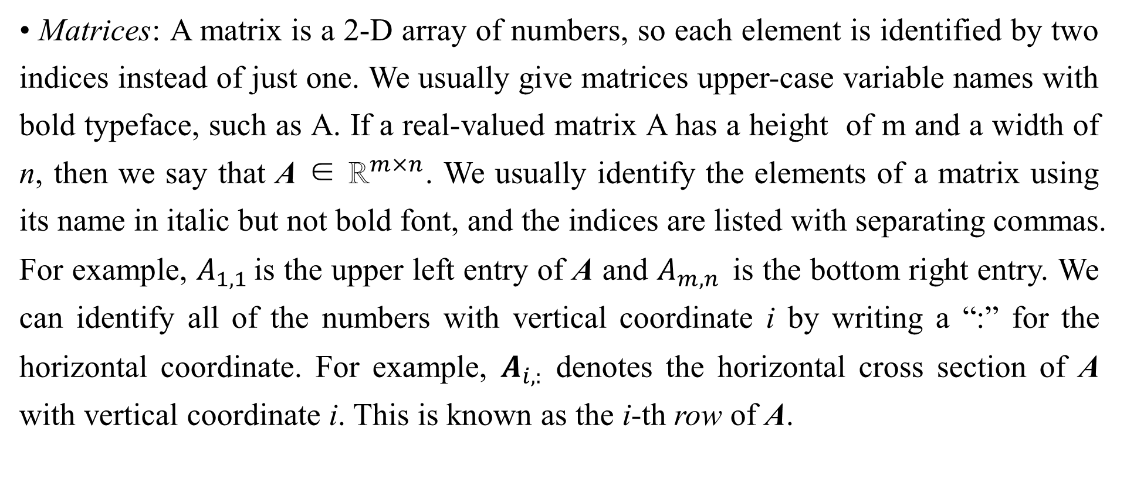
2.1 Scalars, Vectors, Matrices and Tensors
• Matrices: A matrix is a 2-D array of numbers, so each element is identified by two indices instead of just one. We usually give matrices upper-case variable names with bold typeface, such as A. If a real-valued matrix A has a height of m and a width of n, then we say that A ∈ ${\text{ℝ}}^{m×n}$. We usually identify the elements of a matrix using its name in italic but not bold font, and the indices are listed with separating commas. For example, $A_{1,1 }$is the upper left entry of A and $A_{m,n }$is the bottom right entry. We can identify all of the numbers with vertical coordinate i by writing a “:” for the horizontal coordinate. For example, $A_{i,:}$ denotes the horizontal cross section of A with vertical coordinate i. This is known as the i-th row of A.

Slide 12
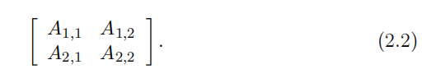
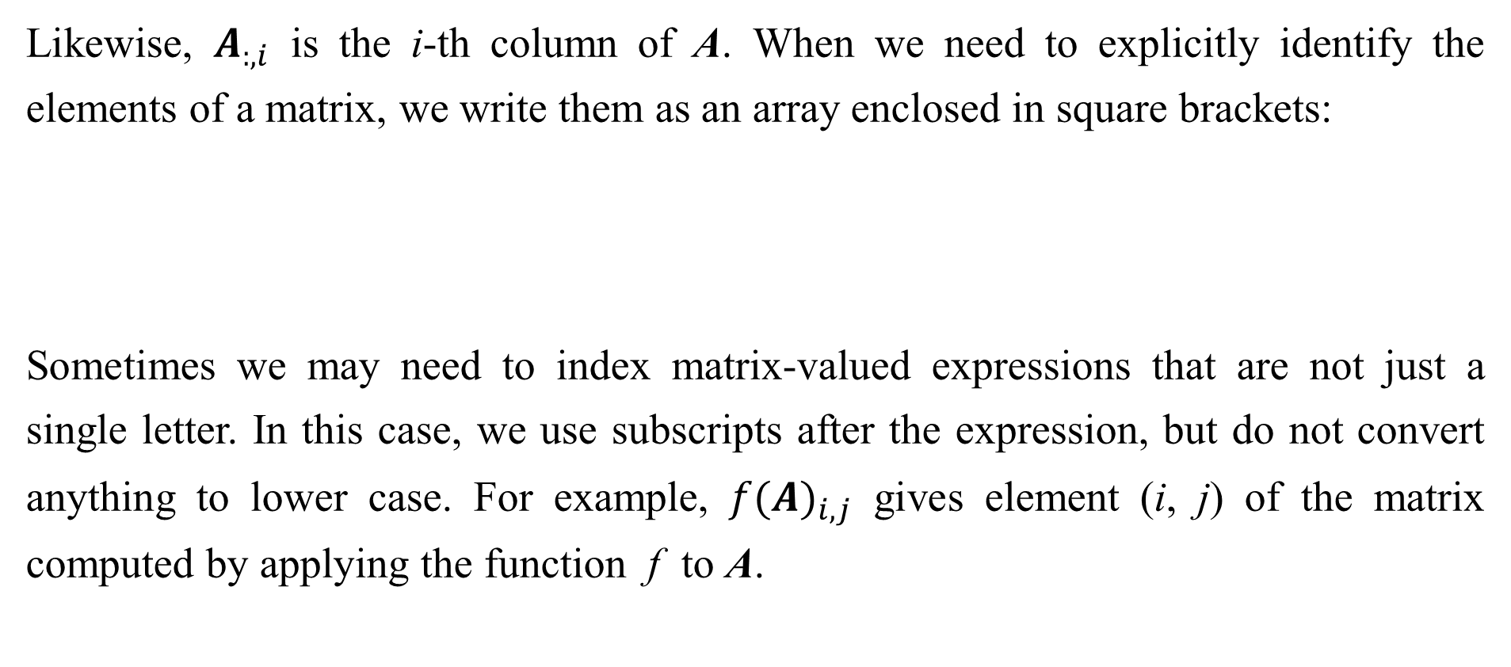
2.1 Scalars, Vectors, Matrices and Tensors
Likewise, $A_{:,i}$ is the i-th column of A. When we need to explicitly identify the elements of a matrix, we write them as an array enclosed in square brackets:
Sometimes we may need to index matrix-valued expressions that are not just a single letter. In this case, we use subscripts after the expression, but do not convert anything to lower case. For example, ${f(A)}_{i,j}$ gives element (i, j) of the matrix computed by applying the function f to A.

Slide 13
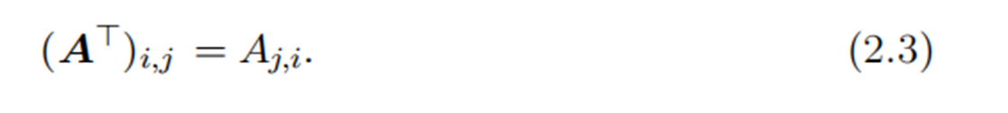
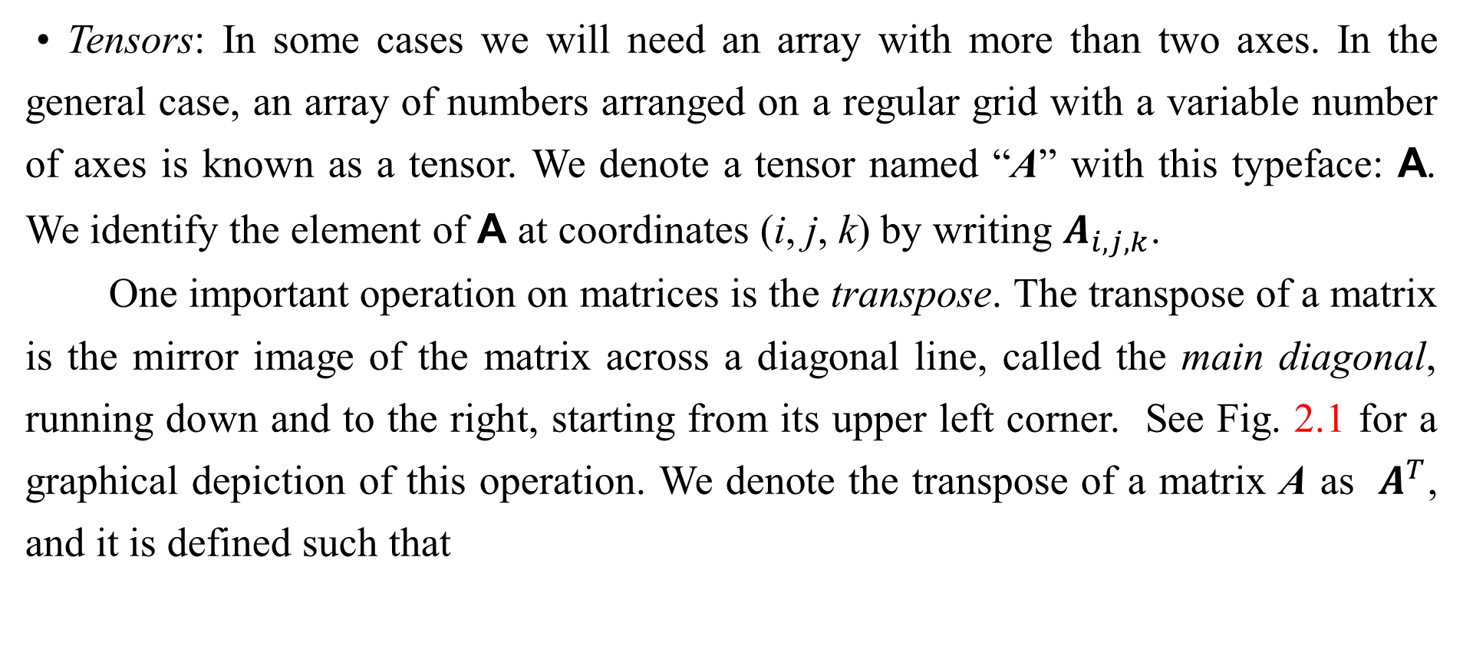
2.1 Scalars, Vectors, Matrices and Tensors
• Tensors: In some cases we will need an array with more than two axes. In the general case, an array of numbers arranged on a regular grid with a variable number of axes is known as a tensor. We denote a tensor named “A” with this typeface: A. We identify the element of A at coordinates (i, j, k) by writing $A_{i,j,k}$.
One important operation on matrices is the transpose. The transpose of a matrix is the mirror image of the matrix across a diagonal line, called the main diagonal, running down and to the right, starting from its upper left corner. See Fig. 2.1 for a graphical depiction of this operation. We denote the transpose of a matrix A as $A^{T}$, and it is defined such that

Slide 14
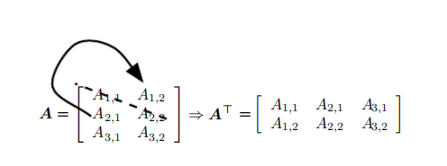
2.1 Scalars, Vectors, Matrices and Tensors
Figure 2.1: The transpose of the matrix can be thought of as a mirror image across the main diagonal.

Slide 15
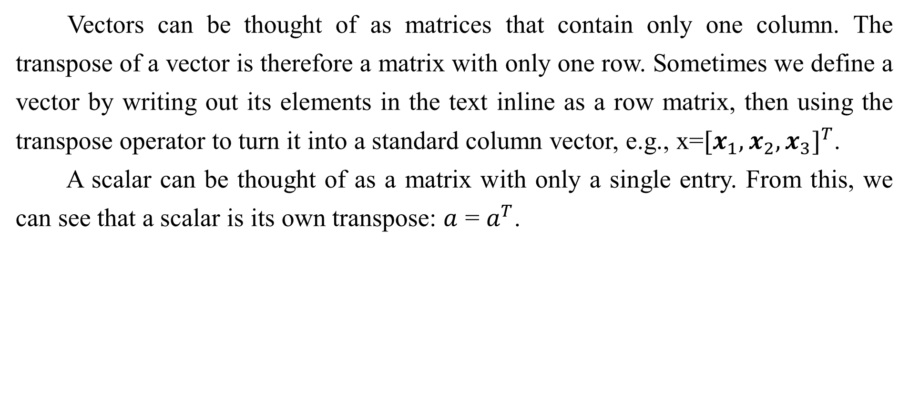
2.1 Scalars, Vectors, Matrices and Tensors
Vectors can be thought of as matrices that contain only one column. The transpose of a vector is therefore a matrix with only one row. Sometimes we define a vector by writing out its elements in the text inline as a row matrix, then using the transpose operator to turn it into a standard column vector, e.g., x=${[x_{1},x_{2},x_{3}]}^{T}$.
A scalar can be thought of as a matrix with only a single entry. From this, we can see that a scalar is its own transpose: $a$ = $a^{T}$.

Slide 16




2.1 Scalars, Vectors, Matrices and Tensors
We can add matrices to each other, as long as they have the same shape, just by adding their corresponding elements: C = A + B where .
We can also add a scalar to a matrix or multiply a matrix by a scalar, just by performing that operation on each element of a matrix: where
In the context of deep learning, we also use some less conventional notation. We allow the addition of matrix and a vector, yielding another matrix: C = A +b, where In other words, the vector b is added to each row of the matrix. This shorthand eliminates the need to define a matrix with b copied into each row before doing the addition. This implicit copying of b to many locations is called broadcasting.

Slide 17
Chapter 2 Linear Algebra
2.2 Multiplying Matrices and Vectors
Acknowledge to: Meiju Wang
Organizers: Guoqiang Zhong, Zhaoyang Niu
Machine Learning Research Group
Ocean University of China
Qingdao, China

Slide 18

2.2 Multiplying Matrices and Vectors
One of the most important operations involving matrices is multiplication of two matrices. The matrix product of matrices A and B is a third matrix C. In order for this product to be defined, A must have the same number of columns as B has rows. If A is of shape m × n and B is of shape n × p, then C is of shape m × p. We can write the matrix product just by placing two or more matrices together, e.g.
The product operation is defined by

Slide 19

2.2 Multiplying Matrices and Vectors
Note that the standard product of two matrices is not just a matrix containing the product of the individual elements. Such an operation exists and is called the element-wise product or Hadamard product, and is denoted as .
The dot product between two vectors x and y of the same dimensionality is the matrix product . We can think of the matrix product C = AB as computing as the dot product between row i of A and column j of B.
Matrix product operations have many useful properties that make mathematical analysis of matrices more convenient. For example, matrix multiplication is distributive:
A(B + C) = AB + AC. (2.6)

Slide 20

2.2 Multiplying Matrices and Vectors
It is also associative:
Matrix multiplication is not commutative (the condition AB = BA does not always hold), unlike scalar multiplication. However, the dot product between two vectors is commutative:
The transpose of a matrix product has a simple form:

Slide 21

2.2 Multiplying Matrices and Vectors
This allows us to demonstrate Eq. 2.8, by exploiting the fact that the value of such a product is a scalar and therefore equal to its own transpose:
Since the focus of this textbook is not linear algebra, we do not attempt to develop a comprehensive list of useful properties of the matrix product here, but the reader should be aware that many more exist.

Slide 22

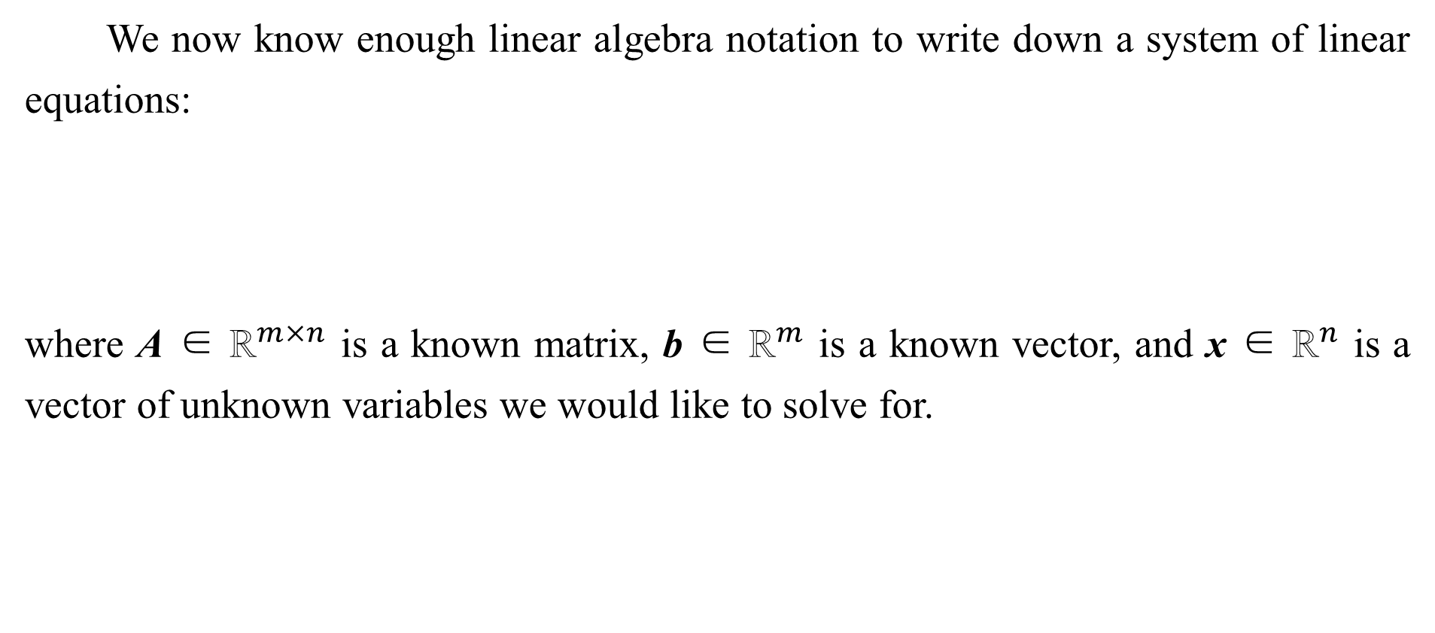
2.2 Multiplying Matrices and Vectors
We now know enough linear algebra notation to write down a system of linear equations:
where A ∈ ${\text{ℝ}}^{m×n}$ is a known matrix, b ∈ ${\text{ℝ}}^{m}$ is a known vector, and x ∈ ${\text{ℝ}}^{n}$ is a vector of unknown variables we would like to solve for.

Slide 23
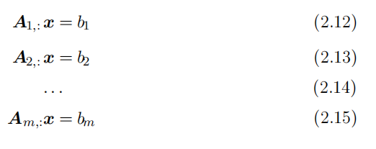

2.2 Multiplying Matrices and Vectors
Each element $x_{i}$ of x is one of these unknown variables. Each row of A and each element of b provide another constraint. We can rewrite Eq. 2.11 as:
or, even more explicitly, as:

Slide 24
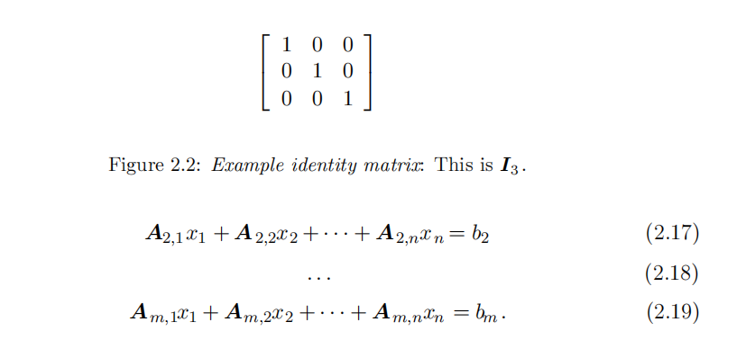
2.2 Multiplying Matrices and Vectors
Matrix-vector product notations provides a more compact representation for equations of this form.

Slide 25
Chapter 2 Linear Algebra
2.3 Identity and Inverse Matrices
Acknowledge to: Meiju Wang
Organizers: Guoqiang Zhong, Zhaoyang Niu
Machine Learning Research Group
Ocean University of China
Qingdao, China

Slide 26

2.3 Identity and Inverse Matrices
Linear algebra offers a powerful tool called matrix inversion that allows us to analytically solve Eq. 2.11 for many values of A.
To describe matrix inversion, we first need to define the concept of an identity matrix. An identity matrix is a matrix that does not change any vector when we multiply that vector by that matrix. We denote the identity matrix that preserves n-dimensional vectors as . Formally, , and
The structure of the identity matrix is simple: all of the entries along the main diagonal are 1, while all of the other entries are zero. See Fig. 2.2 for an example.

Slide 27

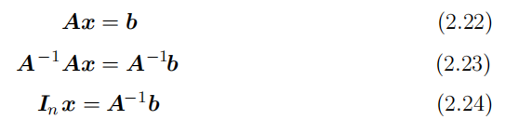

2.3 Identity and Inverse Matrices
The matrix inverse of A is denoted as , and it is defined as the matrix such that
We can now solve Eq. 2.11 by the following steps:

Slide 28

2.3 Identity and Inverse Matrices
Of course, this depends on it being possible to find . We discuss the conditions for the existence of in the following section.
When exists, several different algorithms exist for finding it in closed form. In theory, the same inverse matrix can then be used to solve the equation many times for different values of b. However, is primarily useful as a theoretical tool, and should not actually be used in practice for most software applications. Because
can be represented with only limited precision on a digital computer, algorithms that make use of the value of b can usually obtain more accurate estimates of x.

Slide 29
Chapter 2 Linear Algebra
2.4 Linear Dependence and Span
Acknowledge to: Meiju Wang
Organizers: Guoqiang Zhong, Zhaoyang Niu
Machine Learning Research Group
Ocean University of China
Qingdao, China

Slide 30
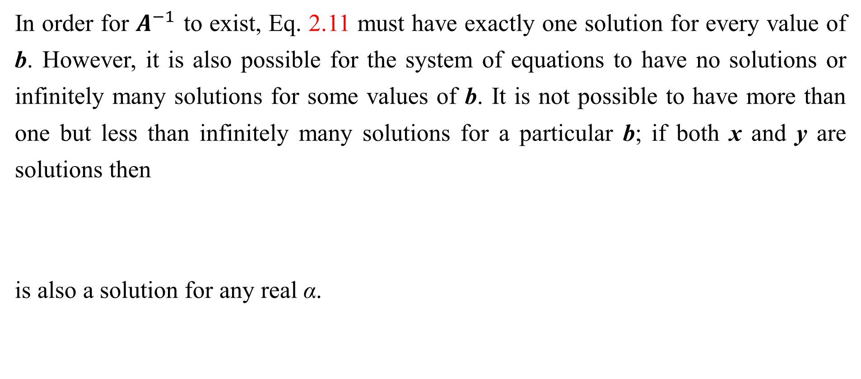
2.4 Linear Dependence and Span
In order for $A^{−1}$ to exist, Eq. 2.11 must have exactly one solution for every value of b. However, it is also possible for the system of equations to have no solutions or infinitely many solutions for some values of b. It is not possible to have more than one but less than infinitely many solutions for a particular b; if both x and y are solutions then
is also a solution for any real α.

Slide 31
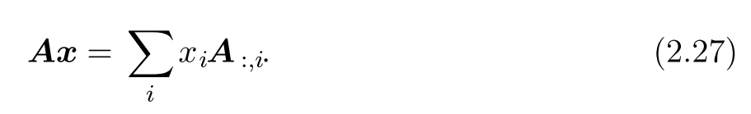

2.4 Linear Dependence and Span
To analyze how many solutions the equation has, we can think of the columns of A as specifying different directions we can travel from the origin (the point specified by the vector of all zeros), and determine how many ways there are of reaching b. In this view, each element of x specifies how far we should travel in each of these directions, with $x_{i}$ specifying how far to move in the direction of column i:

Slide 32



2.4 Linear Dependence and Span
In general, this kind of operation is called a linear combination. Formally, a linear combination of some set of vectors is given by multiplying each vector by a corresponding scalar coefficient and adding the results:
The span of a set of vectors is the set of all points obtainable by linear combination of the original vectors.
Determining whether Ax= b has a solution thus amounts to testing whether b is in the span of the columns of A. This particular span is known as the column space or the range of A.

Slide 33
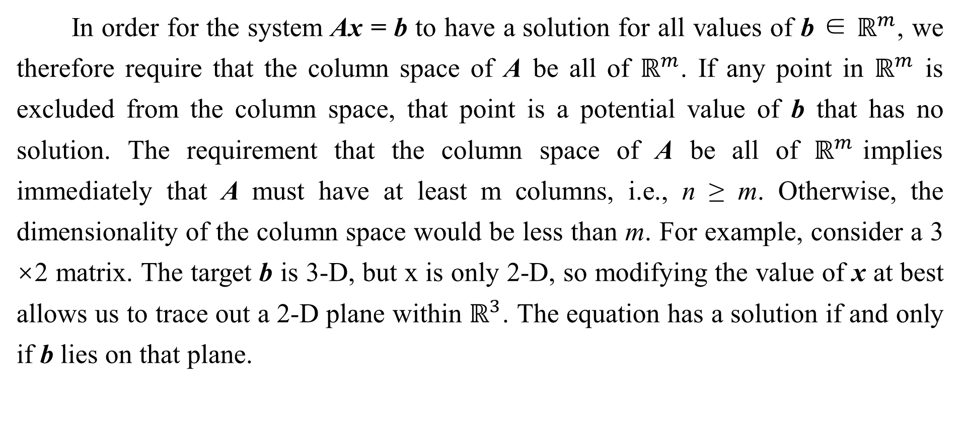
2.4 Linear Dependence and Span
In order for the system Ax = b to have a solution for all values of b ∈ $ℝ^{m}$, we therefore require that the column space of A be all of $ℝ^{m}$. If any point in $ℝ^{m}$ is excluded from the column space, that point is a potential value of b that has no solution. The requirement that the column space of A be all of $ℝ^{m}$implies immediately that A must have at least m columns, i.e., n ≥ m. Otherwise, the dimensionality of the column space would be less than m. For example, consider a 3 ×2 matrix. The target b is 3-D, but x is only 2-D, so modifying the value of x at best allows us to trace out a 2-D plane within $ℝ^{3}$. The equation has a solution if and only if b lies on that plane.

Slide 34
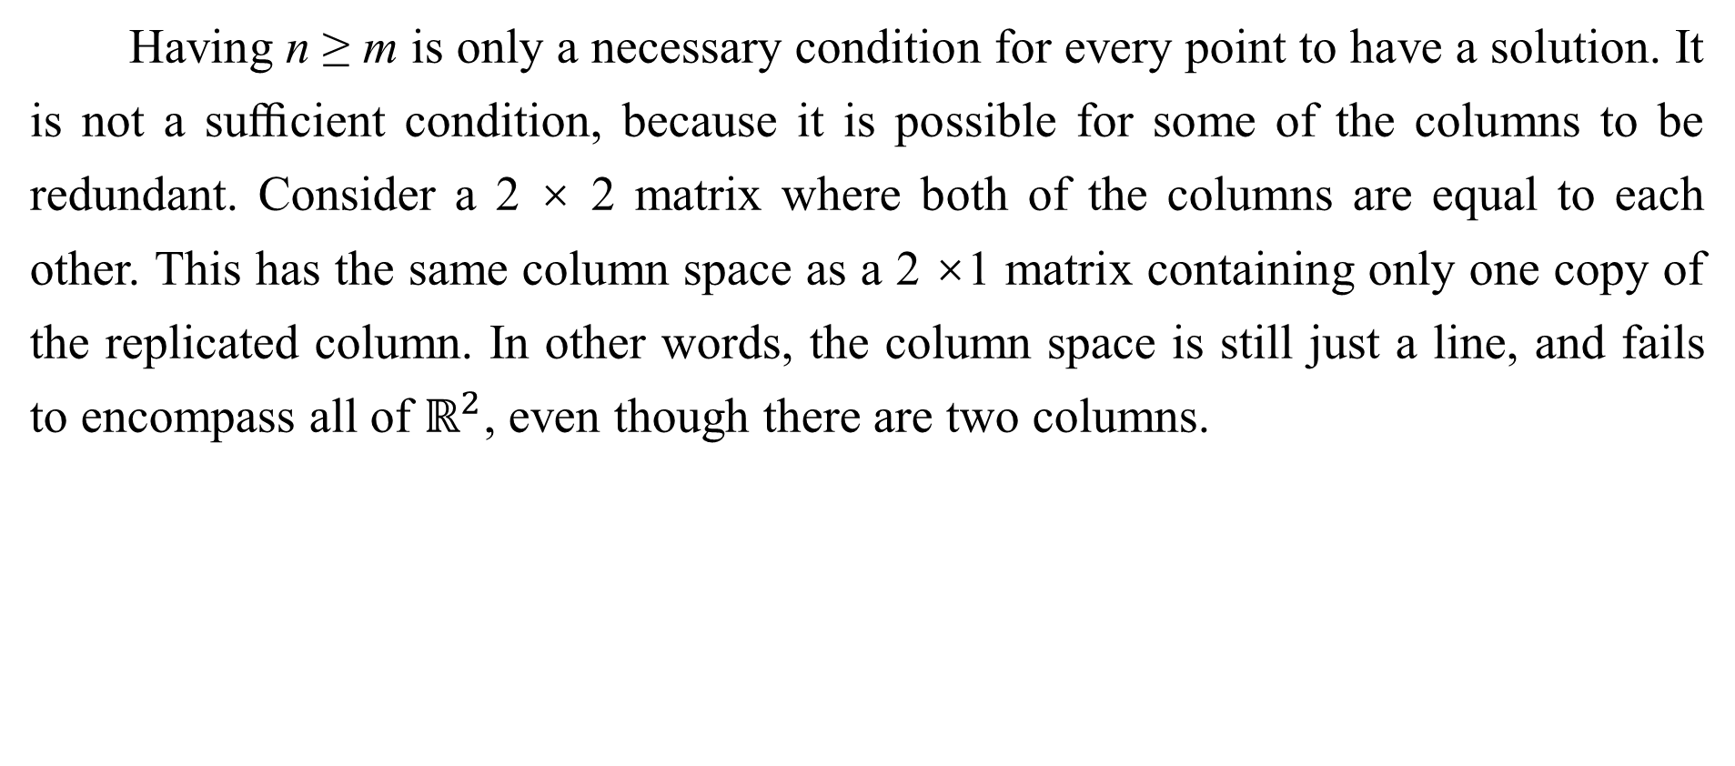
2.4 Linear Dependence and Span
Having n ≥ m is only a necessary condition for every point to have a solution. It is not a suﬃcient condition, because it is possible for some of the columns to be redundant. Consider a 2 × 2 matrix where both of the columns are equal to each other. This has the same column space as a 2 ×1 matrix containing only one copy of the replicated column. In other words, the column space is still just a line, and fails to encompass all of $ℝ^{2}$, even though there are two columns.

Slide 35
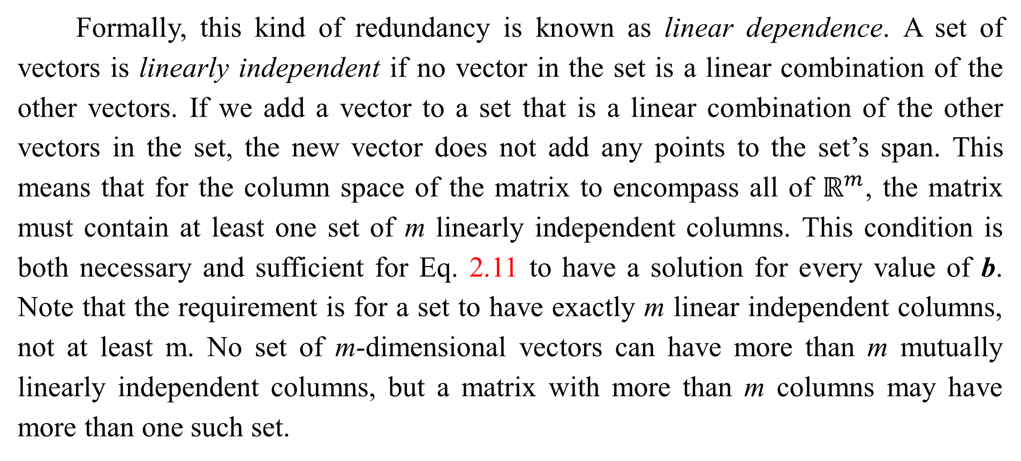
2.4 Linear Dependence and Span
Formally, this kind of redundancy is known as linear dependence. A set of vectors is linearly independent if no vector in the set is a linear combination of the other vectors. If we add a vector to a set that is a linear combination of the other vectors in the set, the new vector does not add any points to the set’s span. This means that for the column space of the matrix to encompass all of $ℝ^{m}$, the matrix must contain at least one set of m linearly independent columns. This condition is both necessary and sufficient for Eq. 2.11 to have a solution for every value of b. Note that the requirement is for a set to have exactly m linear independent columns, not at least m. No set of m-dimensional vectors can have more than m mutually linearly independent columns, but a matrix with more than m columns may have more than one such set.

Slide 36
2.4 Linear Dependence and Span
In order for the matrix to have an inverse, we additionally need to ensure that Eq. 2.11 has at most one solution for each value of b. To do so, we need to ensure that the matrix has at most m columns. Otherwise there is more than one way of parametrizing each solution.
Together, this means that the matrix must be square, that is, we require that m = n and that all of the columns must be linearly independent. A square matrix with linearly dependent columns is known as singular.
If A is not square or is square but singular, it can still be possible to solve the equation. However, we can not use the method of matrix inversion to find the solution.

Slide 37

2.4 Linear Dependence and Span
So far we have discussed matrix inverses as being multiplied on the left. It is also possible to define an inverse that is multiplied on the right:
For square matrices, the left inverse and right inverse are equal.

Slide 38
Chapter 2 Linear Algebra
2.5 Norms
Acknowledge to: Meiju Wang
Organizers: Guoqiang Zhong, Zhaoyang Niu
Machine Learning Research Group
Ocean University of China
Qingdao, China

Slide 39
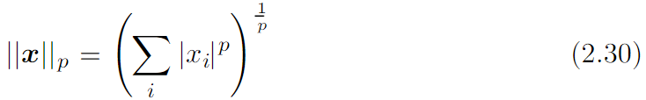

2.5 Norms
Sometimes we need to measure the size of a vector. In machine learning, we usually measure the size of vectors using a function called a norm. Formally, the $L^{p}$ norm is given by
for p ∈ ℝ, p ≥ 1.

Slide 40
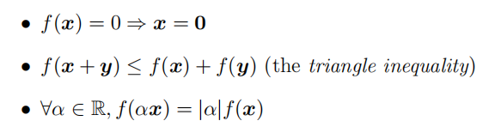

2.5 Norms
Norms, including the $L^{p}$ norm, are functions mapping vectors to non-negative values. On an intuitive level, the norm of a vector x measures the distance from the origin to the point x. More rigorously, a norm is any function f that satisfies the following properties:

Slide 41

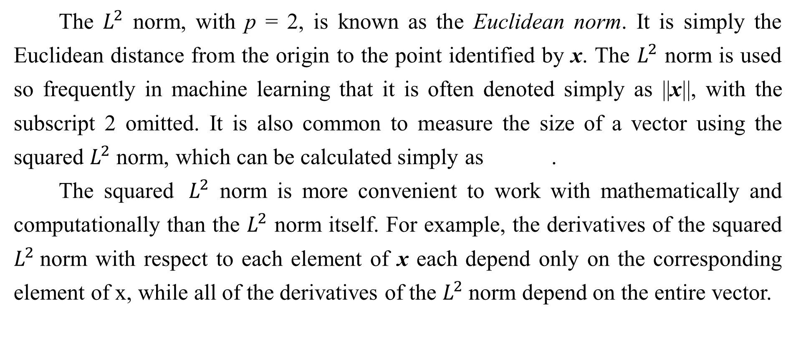
2.5 Norms
The $L^{2}$ norm, with p = 2, is known as the Euclidean norm. It is simply the Euclidean distance from the origin to the point identified by x. The $L^{2}$ norm is used so frequently in machine learning that it is often denoted simply as ||x||, with the subscript 2 omitted. It is also common to measure the size of a vector using the squared $L^{2}$ norm, which can be calculated simply as .
The squared ${ L}^{2}$ norm is more convenient to work with mathematically and computationally than the $L^{2}$ norm itself. For example, the derivatives of the squared $L^{2}$norm with respect to each element of x each depend only on the corresponding element of x, while all of the derivatives of the $L^{2}$norm depend on the entire vector.

Slide 42

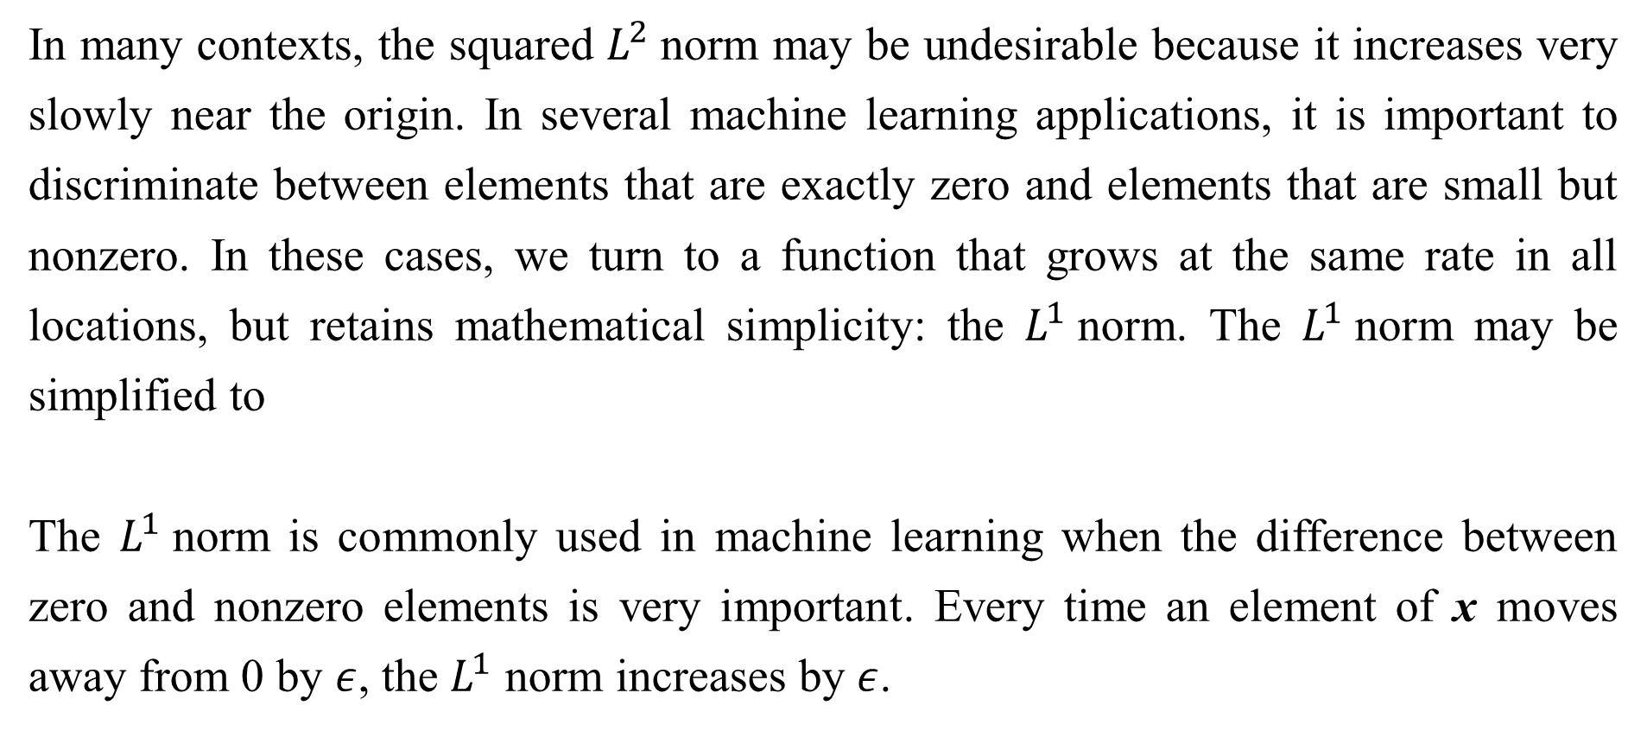
2.5 Norms
In many contexts, the squared $L^{2}$norm may be undesirable because it increases very slowly near the origin. In several machine learning applications, it is important to discriminate between elements that are exactly zero and elements that are small but nonzero. In these cases, we turn to a function that grows at the same rate in all locations, but retains mathematical simplicity: the $L^{1}$norm. The $L^{1}$norm may be simplified to
The $L^{1}$norm is commonly used in machine learning when the difference between zero and nonzero elements is very important. Every time an element of x moves away from 0 by $ε$, the $L^{1}$ norm increases by $ε$.

Slide 43
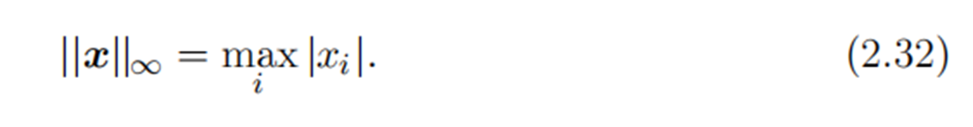
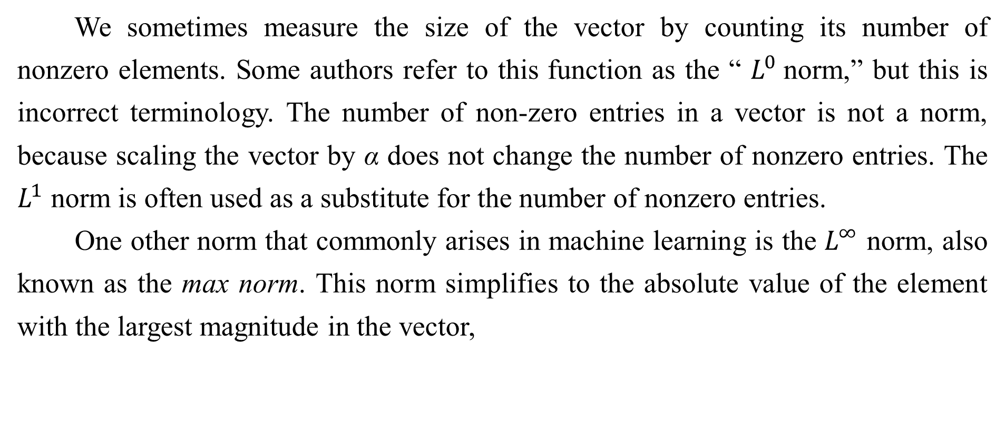
2.5 Norms
We sometimes measure the size of the vector by counting its number of nonzero elements. Some authors refer to this function as the “ $L^{0}$norm,” but this is incorrect terminology. The number of non-zero entries in a vector is not a norm, because scaling the vector by α does not change the number of nonzero entries. The $L^{1}$ norm is often used as a substitute for the number of nonzero entries.
One other norm that commonly arises in machine learning is the $L^{∞}$ norm, also known as the max norm. This norm simplifies to the absolute value of the element with the largest magnitude in the vector,

Slide 44
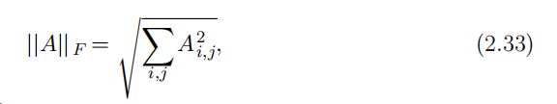
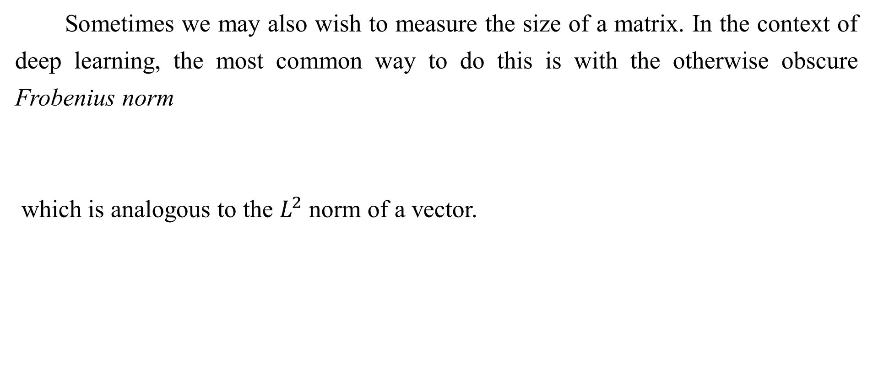
2.5 Norms
Sometimes we may also wish to measure the size of a matrix. In the context of deep learning, the most common way to do this is with the otherwise obscure Frobenius norm
which is analogous to the $L^{2}$ norm of a vector.

Slide 45

2.5 Norms
The dot product of two vectors can be rewritten in terms of norms. Specifically,
where θ is the angle between x and y.

Slide 46
Chapter 2 Linear Algebra
2.6 Special Kinds of Matrices and Vectors
Acknowledge to: Meiju Wang
Organizers: Guoqiang Zhong, Zhaoyang Niu
Machine Learning Research Group
Ocean University of China
Qingdao, China
https://github.com/AdolfKing/DeepLearningSlides

Slide 47


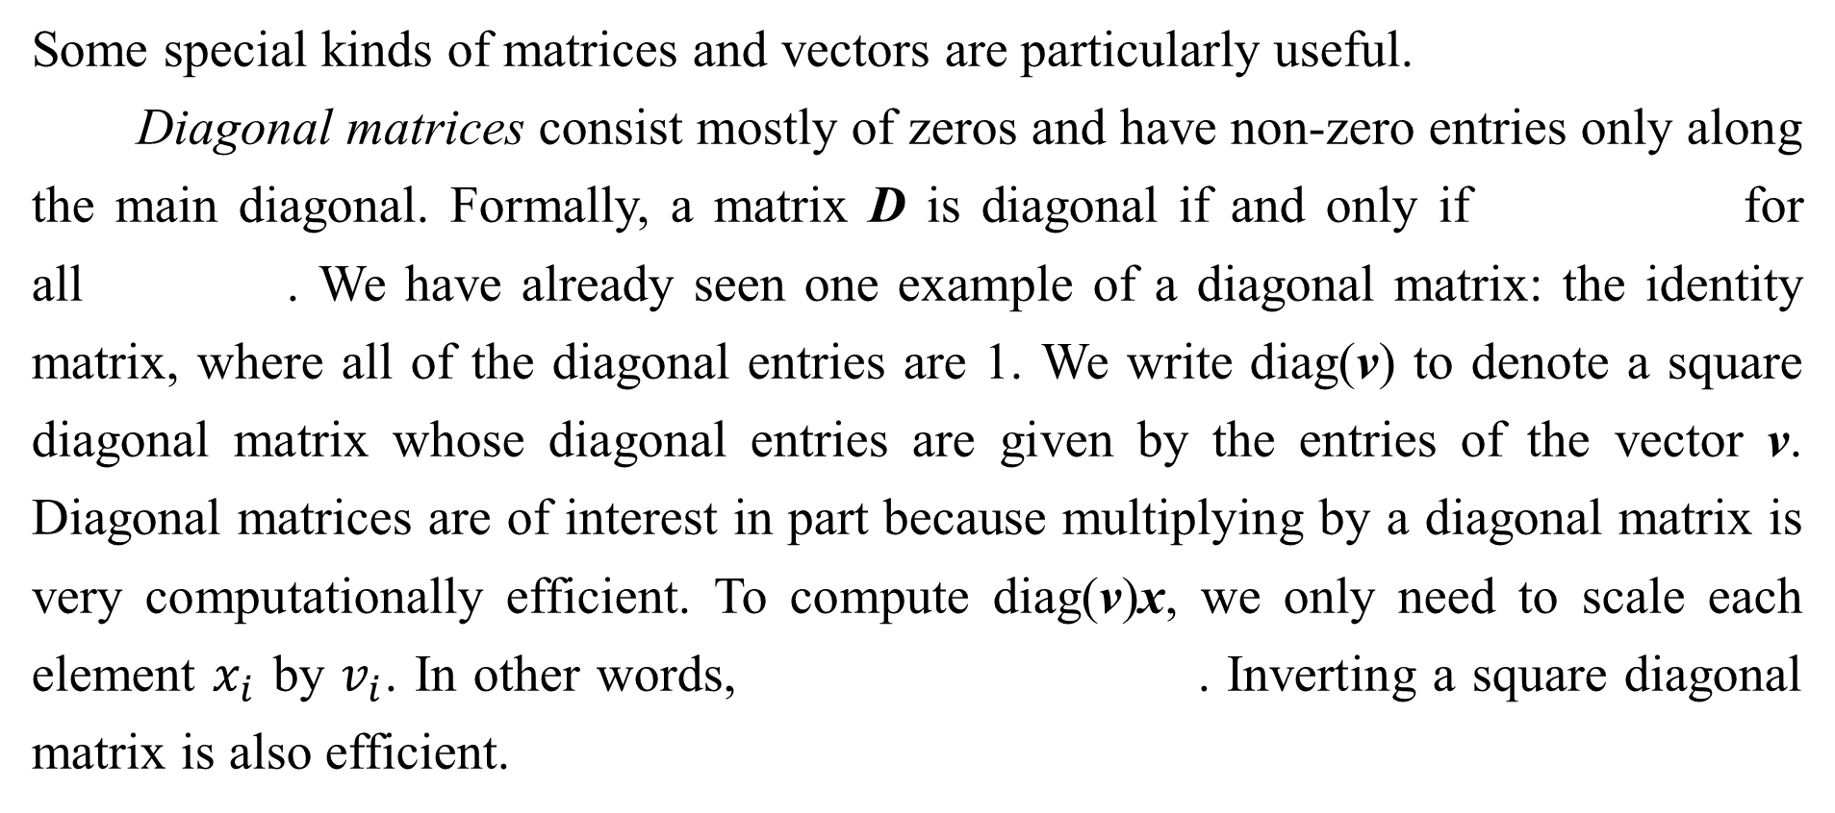
2.6 Special Kinds of Matrices and Vectors
Some special kinds of matrices and vectors are particularly useful.
Diagonal matrices consist mostly of zeros and have non-zero entries only along the main diagonal. Formally, a matrix D is diagonal if and only if for all . We have already seen one example of a diagonal matrix: the identity matrix, where all of the diagonal entries are 1. We write diag(v) to denote a square diagonal matrix whose diagonal entries are given by the entries of the vector v. Diagonal matrices are of interest in part because multiplying by a diagonal matrix is very computationally efficient. To compute diag(v)x, we only need to scale each element $x_{i}$ by $v_{i}$. In other words, . Inverting a square diagonal matrix is also efficient.

Slide 48
2.6 Special Kinds of Matrices and Vectors
The inverse exists only if every diagonal entry is nonzero, and in that case, . In many cases, we may derive some very general machine learning algorithm in terms of arbitrary matrices, but obtain a less expensive (and less descriptive) algorithm by restricting some matrices to be diagonal.
Not all diagonal matrices need be square. It is possible to construct a rectangular diagonal matrix. Non-square diagonal matrices do not have inverses but it is still possible to multiply by them cheaply. For a non-square diagonal matrix D, the product Dx will involve scaling each element of x, and either concatenating some zeros to the result if D is taller than it is wide, or discarding some of the last elements of the vector if D is wider than it is tall.

Slide 49




2.6 Special Kinds of Matrices and Vectors
A symmetric matrix is any matrix that is equal to its own transpose:
Symmetric matrices often arise when the entries are generated by some function of two arguments that does not depend on the order of the arguments. For example, if A is a matrix of distance measurements, with giving the distance from point i to point j, then because distance functions are symmetric.
A unit vector is a vector with unit norm:

Slide 50


2.6 Special Kinds of Matrices and Vectors
A vector x and a vector y are orthogonal to each other if = 0. If both vectors have nonzero norm, this means that they are at a 90 degree angle to each other. In , at most n vectors may be mutually orthogonal with nonzero norm. If the vectors are not only orthogonal but also have unit norm, we call them orthonormal.
An orthogonal matrix is a square matrix whose rows are mutually orthonormal and whose columns are mutually orthonormal:

Slide 51
2.6 Special Kinds of Matrices and Vectors
This implies that
so orthogonal matrices are of interest because their inverse is very cheap to compute. Pay careful attention to the deﬁnition of orthogonal matrices. Counterintuitively, their rows are not merely orthogonal but fully orthonormal. There is no special term for a matrix whose rows or columns are orthogonal but not orthonormal.

Slide 52
Chapter 2 Linear Algebra
2.7 Eigendecomposition
Acknowledge to: Meiju Wang
Organizers: Guoqiang Zhong, Zhaoyang Niu
Machine Learning Research Group
Ocean University of China
Qingdao, China
https://github.com/AdolfKing/DeepLearningSlides

Slide 53
2.7 Eigendecomposition
Many mathematical objects can be understood better by breaking them into constituent parts, or finding some properties of them that are universal, not caused by the way we choose to represent them.
For example, integers can be decomposed into prime factors. The way we represent the number 12 will change depending on whether we write it in base ten or in binary, but it will always be true that 12 = 2×2×3. From this representation we can conclude useful properties, such as that 12 is not divisible by 5, or that any integer multiple of 12 will be divisible by 3.

Slide 54
2.7 Eigendecomposition
Much as we can discover something about the true nature of an integer by decomposing it into prime factors, we can also decompose matrices in ways that show us information about their functional properties that is not obvious from the representation of the matrix as an array of elements.
One of the most widely used kinds of matrix decomposition is called eigen- decomposition, in which we decompose a matrix into a set of eigenvectors and eigenvalues.

Slide 55
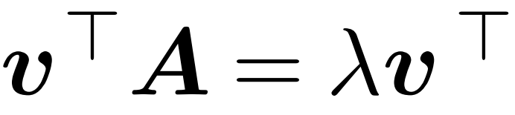
2.7 Eigendecomposition
An eigenvector of a square matrix A is a non-zero vector v such that multipli- cation by A alters only the scale of v:
Av = λv. (2.39)
The scalar λ is known as the eigenvalue corresponding to this eigenvector. (One can also find a left eigenvector such that , but we are usually concerned with right eigenvectors).
If v is an eigenvector of A, then so is any rescaled vector sv for s ∈ , s ≠ 0. Moreover, sv still has the same eigenvalue. For this reason, we usually only look for unit eigenvectors.

Slide 56
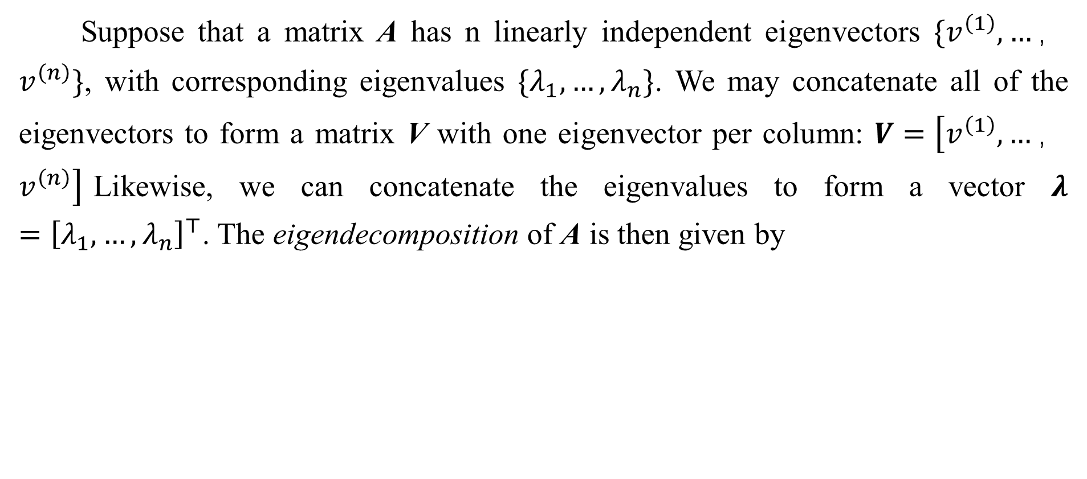
2.7 Eigendecomposition
Suppose that a matrix A has n linearly independent eigenvectors $\{v^{\left(1\right)},…，v^{\left(n\right)}\}$, with corresponding eigenvalues $\{λ_{1},…,λ_{n}\}$. We may concatenate all of the eigenvectors to form a matrix V with one eigenvector per column: $V=\left[v^{\left(1\right)},…，v^{\left(n\right)}\right]$Likewise, we can concatenate the eigenvalues to form a vector $λ={\left[λ_{1},…,λ_{n}\right]}^{⊤}$. The eigendecomposition of A is then given by

Slide 57
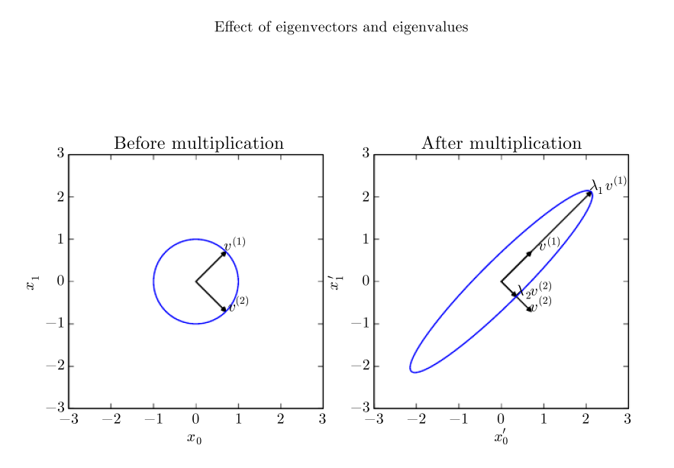
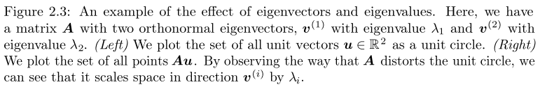
2.7 Eigendecomposition

Slide 58
2.7 Eigendecomposition
We have seen that constructing matrices with specific eigenvalues and eigenvectors allows us to stretch space in desired directions. However, we often want to decompose matrices into their eigenvalues and eigenvectors. Doing so can help us to analyze certain properties of the matrix, much as decomposing an integer into its prime factors can help us understand the behavior of that integer.
Not every matrix can be decomposed into eigenvalues and eigenvectors. In some cases, the decomposition exists, but may involve complex rather than real numbers. Fortunately, in this book, we usually need to decompose only a specific class of matrices that have a simple decomposition.

Slide 59

2.7 Eigendecomposition
Specifically, every real symmetric matrix can be decomposed into an expression using only real-valued eigenvectors and eigenvalues:
where Q is an orthogonal matrix composed of eigenvectors of A, and Λ is a diagonal matrix. The eigenvalue is associated with the eigenvector in column i of Q, denoted as . Because Q is an orthogonal matrix, we can think of A as scaling space by in direction . See Fig. 2.3 for an example.

Slide 60
2.7 Eigendecomposition
While any real symmetric matrix A is guaranteed to have an eigendecomposi- tion, the eigendecomposition may not be unique. If any two or more eigenvectors share the same eigenvalue, then any set of orthogonal vectors lying in their span are also eigenvectors with that eigenvalue, and we could equivalently choose a Q using those eigenvectors instead. By convention, we usually sort the entries of Λ in descending order. Under this convention, the eigendecomposition is unique only if all of the eigenvalues are unique.
The eigendecomposition of a matrix tells us many useful facts about the matrix. The matrix is singular if and only if any of the eigenvalues are 0.

Slide 61


2.7 Eigendecomposition
The eigendecomposition of a real symmetric matrix can also be used to optimize
quadratic expressions of the form . Whenever x is equal to an eigenvector of A, f takes on the value of the corresponding eigenvalue. The maximum value of f within the constraint region is the maximum eigenvalue and its minimum value within the constraint region is the minimum eigenvalue.
A matrix whose eigenvalues are all positive is called positive definite. A matrix whose eigenvalues are all positive or zero-valued is called positive semidefinite. Likewise, if all eigenvalues are negative, the matrix is negative definite, and if all eigenvalues are negative or zero-valued, it is negative semidefinite. Positive semidefinite matrices are interesting because they guarantee that
Positive deﬁnite matrices additionally guarantee that

Slide 62
Chapter 2 Linear Algebra
2.8 Singular Value Decomposition
Acknowledge to: Meiju Wang
Organizers: Guoqiang Zhong, Zhaoyang Niu
Machine Learning Research Group
Ocean University of China
Qingdao, China
https://github.com/AdolfKing/DeepLearningSlides

Slide 63
2.8 Singular Value Decomposition
In Sec. 2.7, we saw how to decompose a matrix into eigenvectors and eigenvalues. The singular value decomposition (SVD) provides another way to factorize a matrix, into singular vectors and singular values. The SVD allows us to discover some of the same kind of information as the eigendecomposition. However, the SVD is more generally applicable. Every real matrix has a singular value decomposition, but the same is not true of the eigenvalue decomposition. For example, if a matrix is not square, the eigendecomposition is not deﬁned, and we must use a singular value decomposition instead.

Slide 64
2.8 Singular Value Decomposition
Recall that the eigendecomposition involves analyzing a matrix A to discover a matrix V of eigenvectors and a vector of eigenvalues λ such that we can rewrite A as
The singular value decomposition is similar, except this time we will write A as a product of three matrices:
Suppose that A is an m × n matrix. Then U is deﬁned to be an m × m matrix, D to be an matrix m× n, and V to be an n × n matrix.

Slide 65
2.8 Singular Value Decomposition
Each of these matrices is deﬁned to have a special structure. The matrices U and V are both deﬁned to be orthogonal matrices. The matrix D is deﬁned to be a diagonal matrix. Note that D is not necessarily square.
The elements along the diagonal of D are known as the of the singular values matrix A. The columns of U are known as the left-singular vectors. The columns of are known as as the V right-singular vectors.

Slide 66


2.8 Singular Value Decomposition
We can actually interpret the singular value decomposition of A in terms of the eigendecomposition of functions of A . The left-singular vectors of A are the eigenvectors of . The right-singular vectors of A are the eigenvectors of . The non-zero singular values of A are the square roots of the eigenvalues of . The same is true for .
Perhaps the most useful feature of the SVD is that we can use it to partially generalize matrix inversion to non-square matrices, as we will see in the next section.

Slide 67
Chapter 2 Linear Algebra
2.9 The Moore-Penrose Pseudoinverse
Acknowledge to: Xiaofan Qu
Organizers: Guoqiang Zhong, Zhaoyang Niu
Machine Learning Research Group
Ocean University of China
Qingdao, China
https://github.com/AdolfKing/DeepLearningSlides

Slide 68
2.9 The Moore-Penrose Pseudoinverse
Matrix inversion is not defined for matrices that are not square. Suppose we want to make a left-inverse B of a matrix A, so that we can solve a linear equation
by left-multiplying each side to obtain
Depending on the structure of the problem, it may not be possible to design a unique mapping from A to B.

Slide 69
2.9 The Moore-Penrose Pseudoinverse
If A is taller than it is wide, then it is possible for this equation to have no solution. If A is wider than it is tall, then there could be multiple possible solutions.
The Moore-Penrose pseudoinverse allows us to make some headway in these cases. The pseudoinverse of A is defined as a matrix

Slide 70
2.9 The Moore-Penrose Pseudoinverse
Practical algorithms for computing the pseudoinverse are not based on this definition, but rather the formula
where U, D and V are the singular value decomposition of A, and the pseudoinverse D⁺ of a diagonal matrix D is obtained by taking the reciprocal of its non-zero elements then taking the transpose of the resulting matrix.

Slide 71
2.9 The Moore-Penrose Pseudoinverse
When A has more columns than rows, then solving a linear equation using the pseudoinverse provides one of the many possible solutions. Specifically, it provides the solution x = A⁺y with minimal Euclidean norm ||x||₂ among all possible solutions.
When A has more rows than columns, it is possible for there to be no solution. In this case, using the pseudoinverse gives us the x for which Ax is as close as possible to y in terms of Euclidean norm ||Ax − y||₂.

Slide 72
Chapter 2 Linear Algebra
2.10 The Trace Operator
Acknowledge to: Xiaofan Qu
Organizers: Guoqiang Zhong, Zhaoyang Niu
Machine Learning Research Group
Ocean University of China
Qingdao, China
https://github.com/AdolfKing/DeepLearningSlides

Slide 73
2.10 The Trace Operator
The trace operator gives the sum of all of the diagonal entries of a matrix:
The trace operator is useful for a variety of reasons. Some operations that are difficult to specify without resorting to summation notation can be specified using matrix products and the trace operator. For example, the trace operator provides an alternative way of writing the Frobenius norm of a matrix:

Slide 74
2.10 The Trace Operator
Writing an expression in terms of the trace operator opens up opportunities to manipulate the expression using many useful identities. For example, the trace operator is invariant to the transpose operator:
The trace of a square matrix composed of many factors is also invariant to moving the last factor into the first position, if the shapes of the corresponding matrices allow the resulting product to be defined:

Slide 75
2.10 The Trace Operator
or more generally,
This invariance to cyclic permutation holds even if the resulting product has a different shape. For example, for A ∈ R^{m×n} and B ∈ R^{n×m}, we have
even though AB ∈ R^{m×m} and BA ∈ R^{n×n}.
Another useful fact to keep in mind is that a scalar is its own trace: a = Tr(a).

Slide 76
Chapter 2 Linear Algebra
2.11 The Determinant
Acknowledge to: Xiaofan Qu
Organizers: Guoqiang Zhong, Zhaoyang Niu
Machine Learning Research Group
Ocean University of China
Qingdao, China
https://github.com/AdolfKing/DeepLearningSlides

Slide 77
2.11 The Determinant
The determinant of a square matrix, denoted det(A), is a function mapping matrices to real scalars. The determinant is equal to the product of all the eigenvalues of the matrix. The absolute value of the determinant can be thought of as a measure of how much multiplication by the matrix expands or contracts space. If the determinant is 0, then space is contracted completely along at least one dimension, causing it to lose all of its volume. If the determinant is 1, then the transformation is volume-preserving.

Slide 78
Chapter 2 Linear Algebra
2.12 Example: Principal Components Analysis
Acknowledge to: Xiaofan Qu
Organizers: Guoqiang Zhong, Zhaoyang Niu
Machine Learning Research Group
Ocean University of China
Qingdao, China
https://github.com/AdolfKing/DeepLearningSlides

Slide 79
2.12 Example: Principal Components Analysis
One simple machine learning algorithm, principal components analysis or PCA can be derived using only knowledge of basic linear algebra.
Suppose we have a collection of m points {x⁽¹⁾ , . . . , x^{(m)}} in R^{n}. Suppose we would like to apply lossy compression to these points. Lossy compression means storing the points in a way that requires less memory but may lose some precision. We would like to lose as little precision as possible.
One way we can encode these points is to represent a lower-dimensional version of them. For each point x^{(i)} ∈ R^{n} we will find a corresponding code vector c^{(i)} ∈ R^{l}. If l is smaller than n, it will take less memory to store the code points than the original data.

Slide 80
2.12 Example: Principal Components Analysis
We will want to find some encoding function that produces the code for an input, f (x) = c, and a decoding function that produces the reconstructed input given its code, x ≈ g(f (x)).
PCA is defined by our choice of the decoding function. Specifically, to make the decoder very simple, we choose to use matrix multiplication to map the code back into R^{n} . Let g(c) = Dc, where D ∈ R^{n×l} is the matrix defining the decoding.
Computing the optimal code for this decoder could be a difficult problem. To keep the encoding problem easy, PCA constrains the columns of D to be orthogonal to each other. (Note that D is still not technically “an orthogonal matrix” unless l = n)

Slide 81
2.12 Example: Principal Components Analysis
With the problem as described so far, many solutions are possible, because we can increase the scale of D_{:,i} if we decrease c_{i} proportionally for all points. To give the problem a unique solution, we constrain all of the columns of D to have unit norm.
In order to turn this basic idea into an algorithm we can implement, the first thing we need to do is figure out how to generate the optimal code point c∗ for each input point x. One way to do this is to minimize the distance between the input point x and its reconstruction, g(c∗). We can measure this distance using a norm. In the principal components algorithm, we use the L² norm:

Slide 82
2.12 Example: Principal Components Analysis
We can switch to the squared L² norm instead of the L² norm itself, because both are minimized by the same value of c. This is because the L² norm is non- negative and the squaring operation is monotonically increasing for non-negative arguments.
The function being minimized simplifies to
(by the definition of the L² norm, Eq. 2.30)

Slide 83
2.12 Example: Principal Components Analysis
(by the distributive property)
(because the scalar g(x)^{T} x is equal to the transpose of itself).
We can now change the function being minimized again, to omit the first term, since this term does not depend on c:

Slide 84
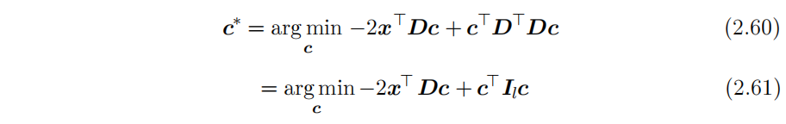
2.12 Example: Principal Components Analysis
To make further progress, we must substitute in the definition of g(c):
(by the orthogonality and unit norm constraints on D)

Slide 85
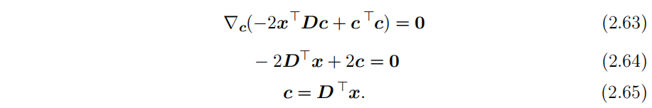
2.12 Example: Principal Components Analysis
We can solve this optimization problem using vector calculus (see Sec. 4.3 if you do not know how to do this):
This makes the algorithm efficient: we can optimally encode x just using a matrix-vector operation. To encode a vector, we apply the encoder function

Slide 86
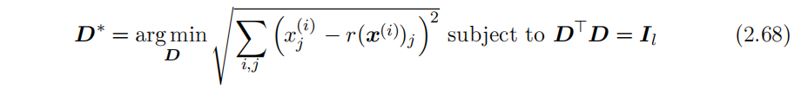
2.12 Example: Principal Components Analysis
Using a further matrix multiplication, we can also define the PCA reconstruction operation:
Next, we need to choose the encoding matrix D. To do so, we revisit the idea of minimizing the L² distance between inputs and reconstructions. However, since we will use the same matrix D to decode all of the points, we can no longer consider the points in isolation. Instead, we must minimize the Frobenius norm of the matrix of errors computed over all dimensions and all points:

Slide 87
2.12 Example: Principal Components Analysis
To derive the algorithm for finding D∗, we will start by considering the case where l = 1. In this case, D is just a single vector, d. Substituting Eq. 2.67 into Eq. 2.68 and simplifying D into d, the problem reduces to
The above formulation is the most direct way of performing the substitution, but is not the most stylistically pleasing way to write the equation. It places the scalar value d^{T}x^{(i)} on the right of the vector d. It is more conventional to write scalar coefficients on the left of vector they operate on.

Slide 88
2.12 Example: Principal Components Analysis
We therefore usually write such a formula as
or, exploiting the fact that a scalar is its own transpose, as
The reader should aim to become familiar with such cosmetic rearrangements.

Slide 89
2.12 Example: Principal Components Analysis
At this point, it can be helpful to rewrite the problem in terms of a single design matrix of examples, rather than as a sum over separate example vectors. This will allow us to use more compact notation. Let X ∈ R^{m×n} be the matrix defined by stacking all of the vectors describing the points, such that . We can now rewrite the problem as

Slide 90
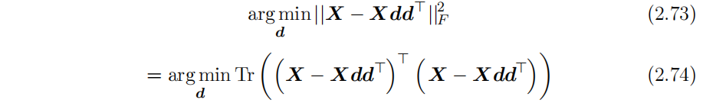
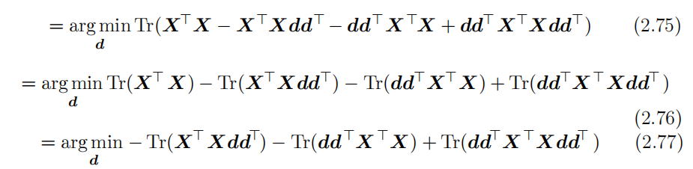
2.12 Example: Principal Components Analysis
Disregarding the constraint for the moment, we can simplify the Frobenius norm portion as follows:
(by Eq. 2.49)

Slide 91
2.12 Example: Principal Components Analysis
(because terms not involving d do not affect the arg min)
(because we can cycle the order of the matrices inside a trace, Eq. 2.52)
(using the same property again)

Slide 92
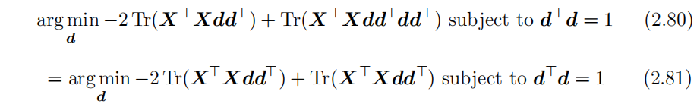
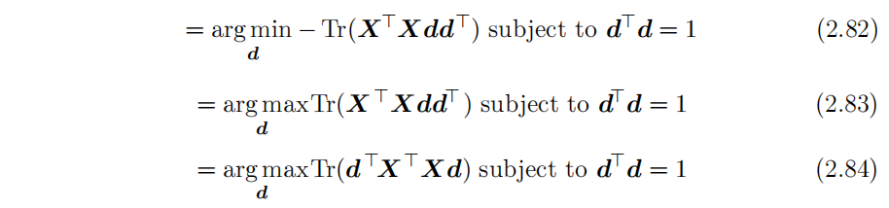
2.12 Example: Principal Components Analysis
At this point, we re-introduce the constraint:
(due to the constraint)

Slide 93
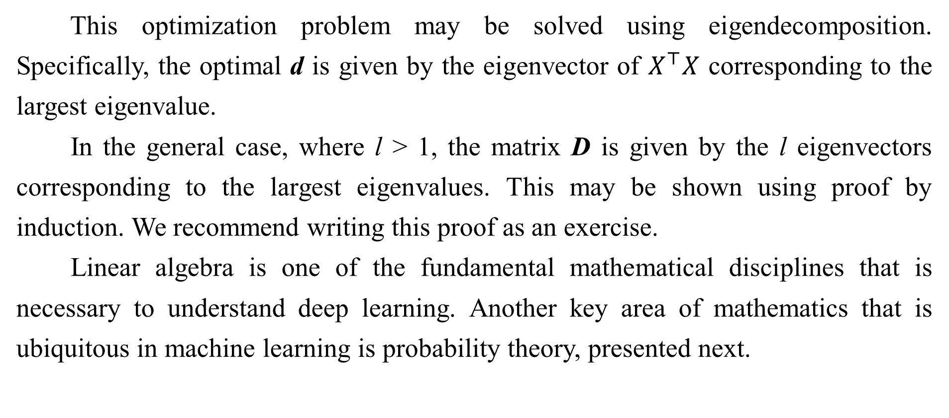
2.12 Example: Principal Components Analysis
This optimization problem may be solved using eigendecomposition. Specifically, the optimal d is given by the eigenvector of $X^{⊤}X$ corresponding to the largest eigenvalue.
In the general case, where l > 1, the matrix D is given by the l eigenvectors corresponding to the largest eigenvalues. This may be shown using proof by induction. We recommend writing this proof as an exercise.
Linear algebra is one of the fundamental mathematical disciplines that is necessary to understand deep learning. Another key area of mathematics that is ubiquitous in machine learning is probability theory, presented next.

Slide 94
References
Ian Goodfellow, Yoshua Bengio and Aaron Courville. Deep Learning, MIT Press, 2016. http://www.deeplearningbook.org.
Guoqiang Zhong, Xiao Ling, Li-Na Wang: From shallow feature learning to deep learning: Benefits from the Width and Depth of Deep Architectures. Wiley Interdiscip. Rev. Data Min. Knowl. Discov. 9(1), 2019.
Guoqiang Zhong, Li-Na Wang, Xiao Ling, Junyu Dong: An Overview on Data Representation Learning: From Traditional Feature Learning to Recent Deep Learning. The Journal of Finance and Data Science 2(4): 265-278, 2016.

Slide 95
Thank you!
The ebooks, papers and materials referred for these slides are downloaded from the Internet. If any of them infringe your rights, please let’s know via email address gqzhong@ouc.edu.cn. If it is true, we will delete the corresponding content immediately. These slides can be freely utilized for teaching and research. For commercial usage, please let’s know first via the same email as above.

